Slide 1
COMPUTER NETWORKS (CS212) LAB 5
Reference to assignment 5

Slide 2

Agenda
The Basic HTTP/GET response interaction.
The HTTP CONDITIONAL GET/response interaction.
Retrieving Long Documents.
HTML Documents with Embedded Objects.
HTTP Authentication.

Slide 3
The Basic HTTP/GET response interaction.

Slide 4
The Basic HTTP GET/response interaction
A client (browser) sends an HTTP request using GET method to the server.
Then the server returns a response to the client.
The response contains status information about the request and may also contain the requested content.

Slide 5



The Basic HTTP/GET response interaction
URL + GET/POST
HTTP Request GET
World Wide Web or Internet
HTTP Response
Status code + Message

Slide 6
HTTP GET/response
Steps
1. Started wireshark.
2. Accessed the URL:
http://gaia.cs.umass.edu/wireshark-labs/HTTP-wireshark-file1.html
3. Stopped wireshark capture.
4.Typed http in wireshark filter box.

Slide 7
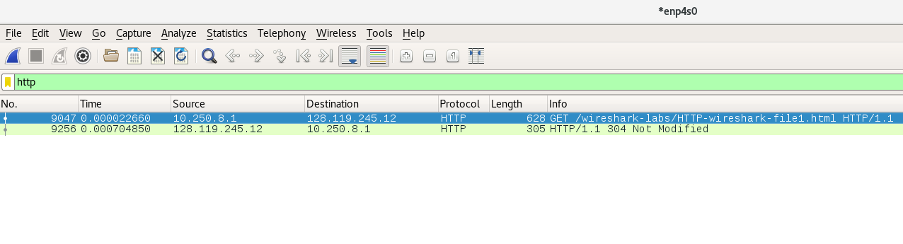
HTTP GET/response

Slide 8
HTTP GET
1. The GET method is used to retrieve information from the given server using a given URI
2. HTTP GET packets displays source(local machine) and server(remote machine ) ip addresses, HTTP version.
3. The packet listing of HTTP GET also shows accepted file types,accepted encoding,accepted languages and user agent.
4. It also displays the full URI searched.

Slide 9
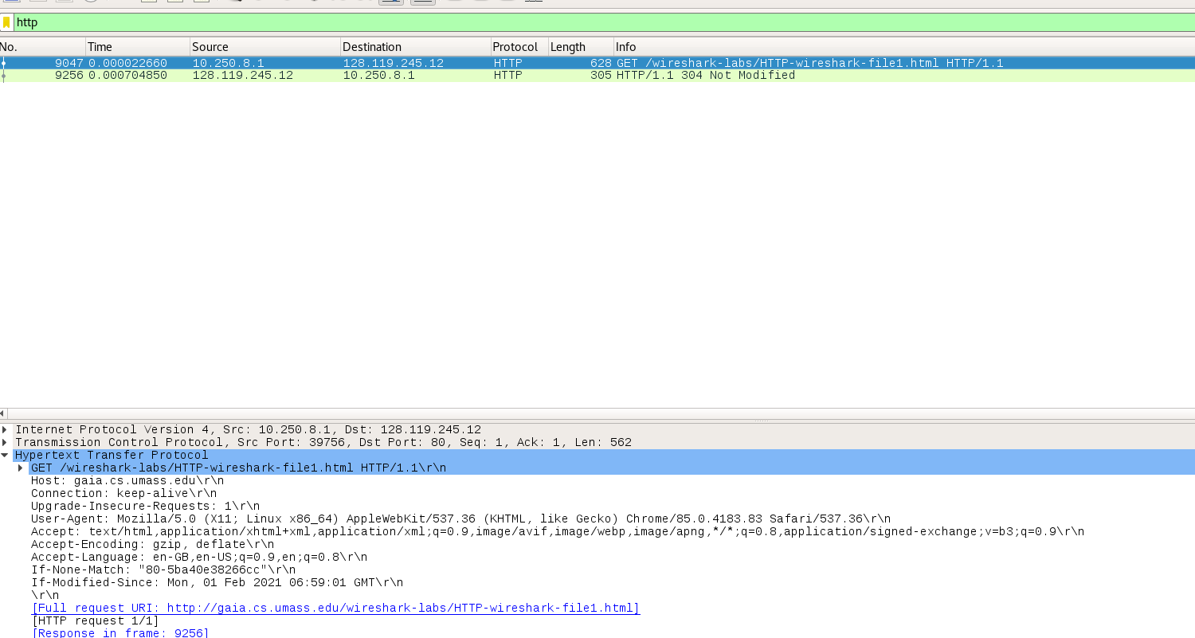
HTTP GET

Slide 10
HTTP Response
HTTP Response is the packet of information sent by Server to the Client in response to an earlier Request made by Client.
HTTP response status codes indicate whether a specific HTTP request has been successfully completed. Responses are grouped in five classes:
Informational responses (100–199)
Successful responses (200–299)
Redirects (300–399)
Client errors (400–499)
Server errors (500–599)
3. HTTP response also displays date,last modified,content length,content type,file date,etc.
4. HTTP response message consists of a status line, followed by header lines, followed by a blank line, followed by the entity body.

Slide 11
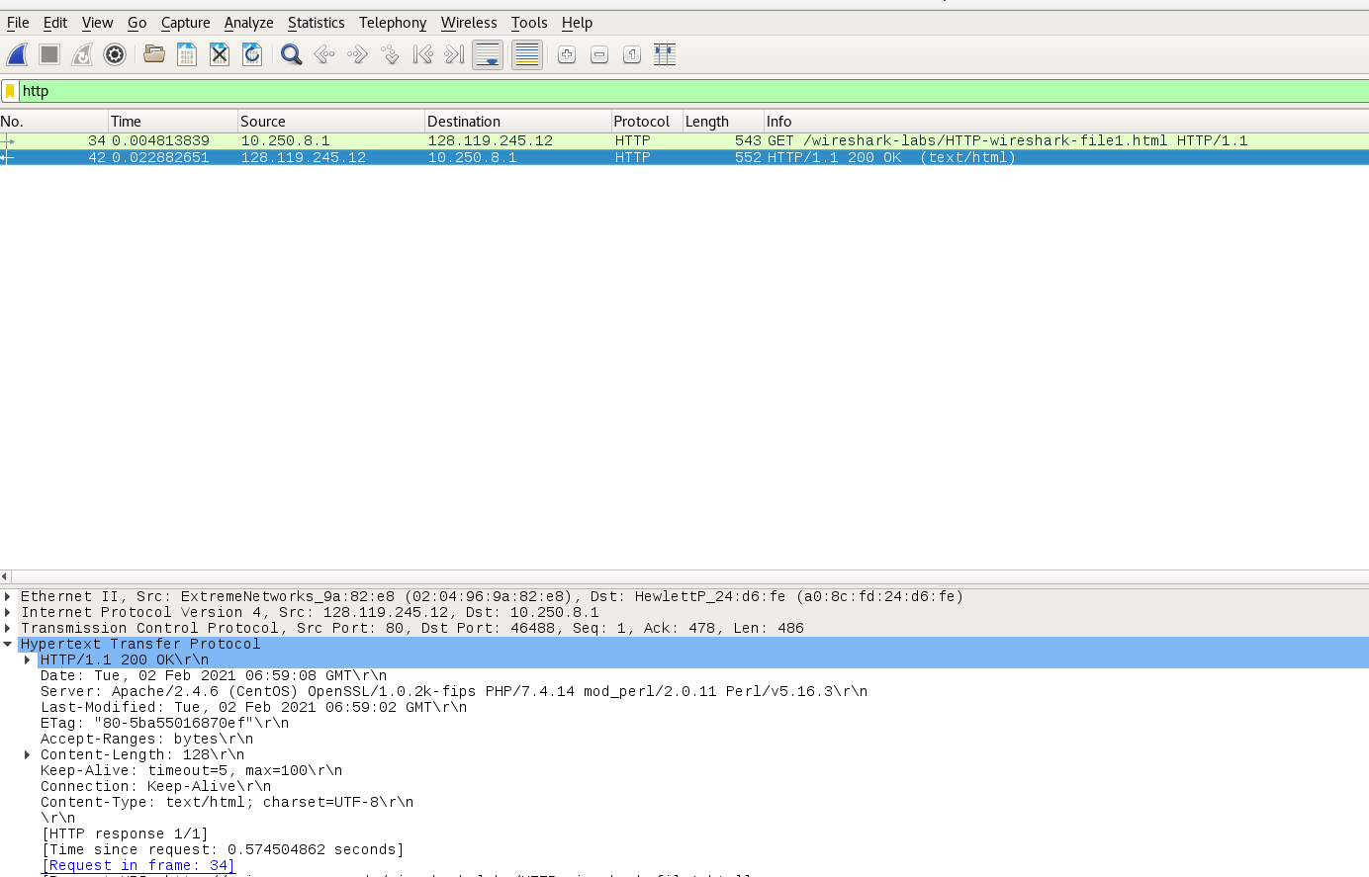
HTTP Response

Slide 12
2. The HTTP CONDITIONAL GET/response interaction

Slide 13
The HTTP CONDITIONAL GET/response interaction
A conditional GET is an HTTP GET request that may return an HTTP 304 response (instead of HTTP 200).
An HTTP 304 response indicates that the resource has not been modified since the previous GET, and so the resource is not returned to the client in such a response.
Sends the updated content (in case there was some modification done) – HTTP 200 response-message code

Slide 14

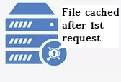
The HTTP CONDITIONAL GET/response interaction
URL + GET/POST
HTTP Request GET
HTTP Conditional GET
If-Modified-Since- date
If-None-Match-etag
World Wide Web or Internet
HTTP Response
HTTP 1.1/ 304 Not modified

Slide 15
HTTP CONDITIONAL GET/response
Steps
1.Start up your web browser, and make sure your browser’s cache is cleared.
2.Start up the Wireshark packet sniffer
3. Enter the following URL into your browser http://gaia.cs.umass.edu/wireshark-labs/HTTP-wireshark-file2.html Your browser should display a very simple five-line HTML file.
4. Quickly enter the same URL into your browser again (or simply select the refresh button on your browser).
5. Stop Wireshark packet capture, and enter “http” in the display-filter-specification window,

Slide 16
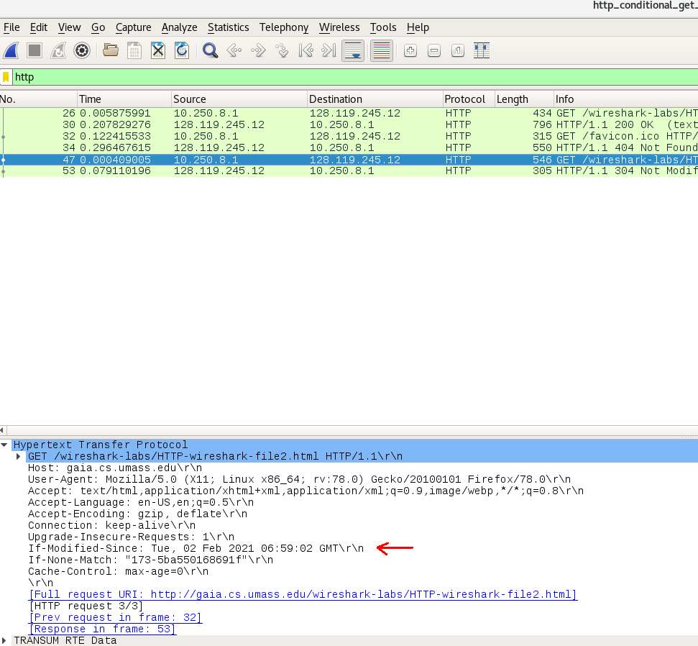

Slide 17
If-Modified-Since HTTP header
It indicates the time for which a browser first downloaded a resource from the server. This helps to determine whether the resource has changed or not, since the last time it was accessed. If the status of a particular resource is 304 Not Modified, this means that the file has not changed and there is no need to download it again.
If-None-Match HTTP Header
It is used to update the entity tags on the server.
Cache-control HTTP Header
It is used to specify browser caching policies in both client requests and server responses. Policies include how a resource is cached, where it’s cached and its maximum age before expiring (i.e., time to live).

Slide 18
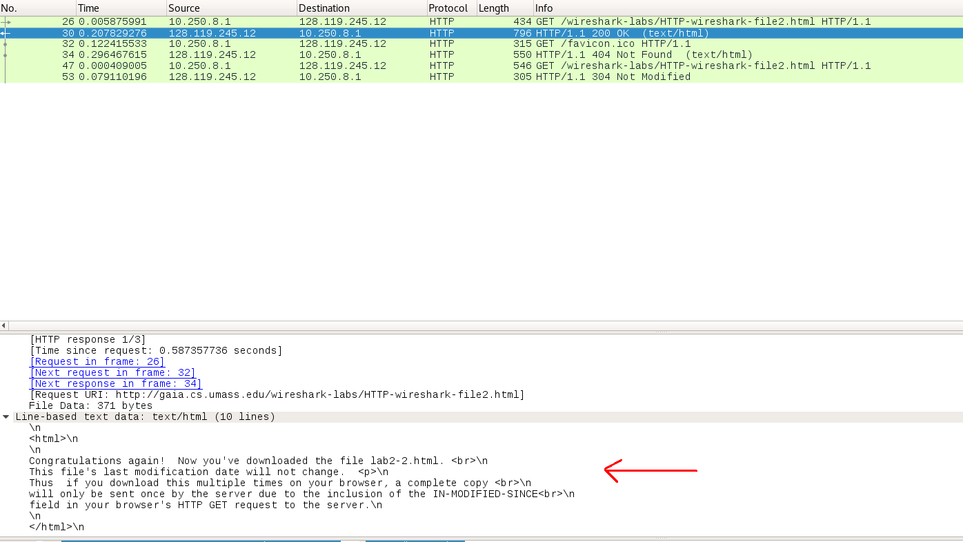
Server returning content of file explicitly

Slide 19
3. Retrieving Long Documents

Slide 20
Retrieving Long Documents
We are downloading a large document which is around 4500 bytes in size.
But 4500 bytes is too large to fit in one TCP packet.
So the single HTTP response message is thus broken into several pieces by TCP, with each piece being contained within a separate TCP segment.
Each TCP segment is recorded as a separate packet by Wireshark, and the fact that the single HTTP response was fragmented across multiple TCP packets.

Slide 21

Retrieving Long Documents
Large document of 4500 bytes
HTTP Request GET
World Wide Web or Internet
HTTP Response
1448 bytes
3 TCP segments of large documents
Reassembled TCP total data 4861 bytes
2896 bytes
517 bytes

Slide 22
Retrieving Long Documents
Steps
Start up your web browser, and make sure your browser’s cache is cleared, as discussed above. •
Start up the Wireshark packet sniffer.
Enter the following URL into your browser http://gaia.cs.umass.edu/wireshark-labs/HTTP-wireshark-file3.html Your browser should display the rather lengthy US Bill of Rights.
Stop Wireshark packet capture, and enter “http” in the display-filter-specification window, so that only captured HTTP messages will be displayed.

Slide 23
What does TCP segment of reassembled PDU means?
A "PDU" is a "Protocol Data Unit." One unit of information being transferred in accordance with a given protocol (e.g., "login USERNAME very-long-base64-encoded-authentication-data or while downloading very large file" then wait for server to respond) will be disassembled into many packets (smaller pieces) if it's too large to fit in one packet (or segment in this case).
What is Payload?
It is the "actual data" in a packet or file minus all headers attached for transport and minus all descriptive meta-data. In a network packet, headers are appended to the payload for transport and then discarded at their destination.

Slide 24
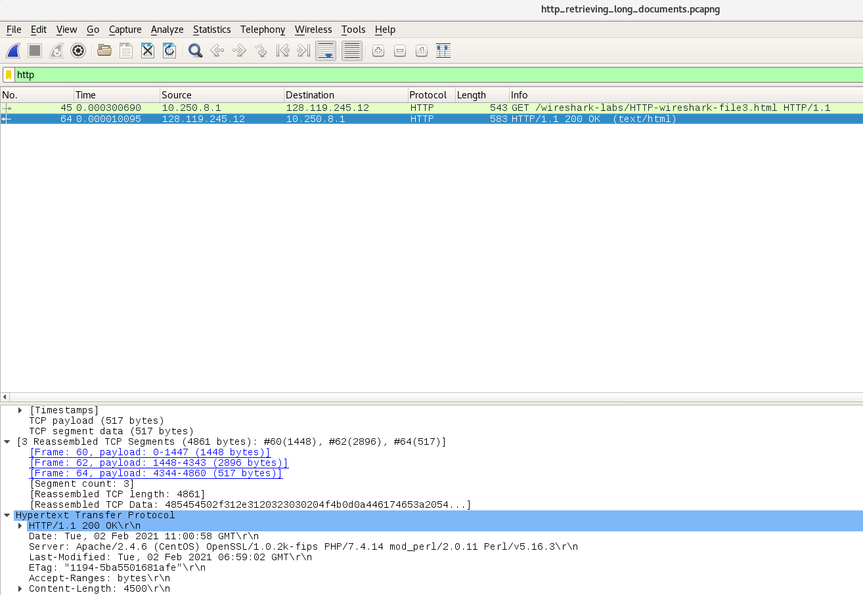

Slide 25
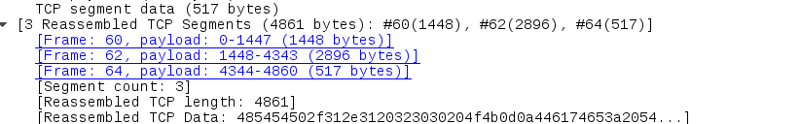
Here we see three TCP segments as the segment count is 3.
1. Frame : 60 with 1448 bytes
2. Frame : 62 with 2896 bytes
3. Frame : 64 with 517 bytes
Total data transmitted = 1448+2896+517
= 4861 bytes

Slide 26
4. HTML Documents with Embedded Objects

Slide 27
HTML Documents with Embedded Objects
We are downloading the file with embedded objects i.e., a file that includes other objects (here image files) that are stored on another server(s).
The images themselves are not contained in the HTML; instead the URLs for the images are contained in the downloaded HTML file.
The browser will retrieve these images from the indicated web sites.

Slide 28

HTML Documents with Embedded Objects
HTTP Request GET- Link with embedded images
World Wide Web or Internet
HTTP Response
cover.png
Logo.png
Server 1
Server 2

Slide 29
HTML Documents with Embedded Objects
Steps
1.Start up your web browser, and make sure your browser’s cache is cleared, as discussed above.
2. Start up the Wireshark packet sniffer.
3. Enter the following URL into your browser http://gaia.cs.umass.edu/wireshark-labs/HTTP-wireshark-file4.html Your browser should display a short HTML file with two images.
4. Stop Wireshark packet capture, and enter “http” in the display-filter-specification window, so that only captured HTTP messages will be displayed.

Slide 30
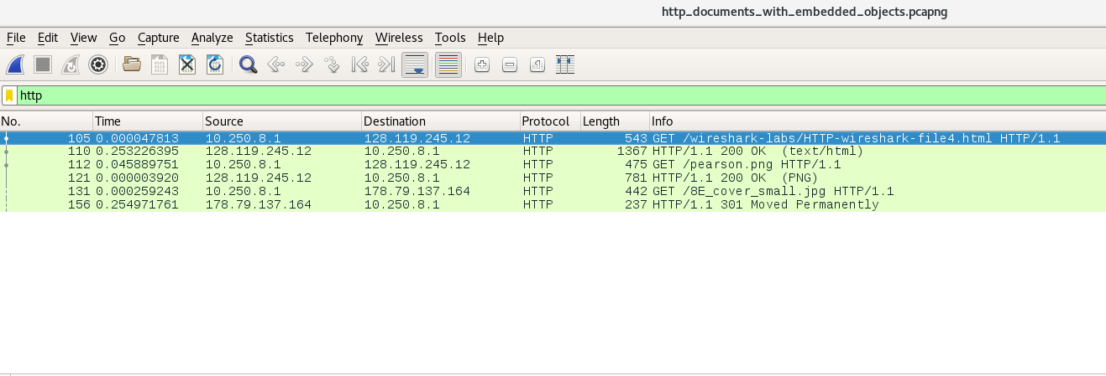

Slide 31
In the screenshot,we can see two 3 HTTP GET requests.One for when we enter the url.Other two are when the images are downloaded.
The publisher’s logo is retrieved from the gaia.cs.umass.edu web site. The image of the cover for the 5th edition is stored at the caite.cs.umass.edu server. (These are two different web servers inside cs.umass.edu).
We see two web servers here
128.119.245.12 - for downloading pearson.png image (logo image)
178.79.137.164 - for downloading cover page image

Slide 32
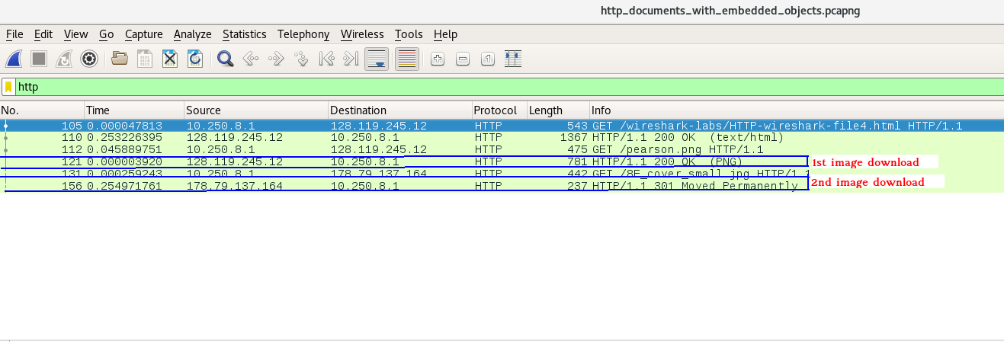
We see Images were downloaded serially. The time stamp shows that the png image was downloaded after the 2nd GET and the jpg image was downloaded after the 3th GET request.

Slide 33
5. HTTP Authentication

Slide 34
HTTP Authentication
The HTTP authentication scheme works as follows:
The client sends a request to the server for a specific page or an API resource.
The server responds to the client with a 401 (Unauthorized) status code and provides information on how to authorize with the WWW-Authenticate header.
The client then sends another request, including the Authorization header with credentials.
If the credentials are valid, the server responds with the requested page or an API resource or with the 403 (Forbidden) status code if the credentials are invalid.

Slide 35
HTTP Authentication
HTTP Request GET - to secured website
No credentials
World Wide Web or Internet
Ask User
HTTP Response - 401 Unauthorized
Check credentials
GET Authorization Basic : d2lyZXNoYXJrLXN0dWRlbnRzOm5ldHdvcms=
HTTP Response - 200 OK

Slide 36
HTTP Authentication
Steps
Make sure your browser’s cache is cleared, as discussed earlier, and close down your browser.
Then, start up your browser.
Start up the Wireshark packet sniffer • Enter the following URL into your browser http://gaia.cs.umass.edu/wireshark-labs/protected_pages/HTTP-wiresharkfile5.html Type the requested user name and password into the pop up box.
Stop Wireshark packet capture, and enter “http” in the display-filter-specification window

Slide 37
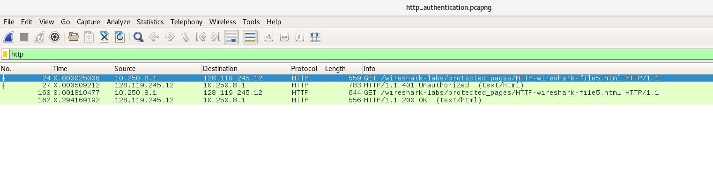

Slide 38
We see two HTTP GET and HTTP responses.
The first HTTP GET loads the entered URL in the browser.
The second HTTP response is sent as a response to first HTTP GET.The status code of the server response to the initial HTTP GET request was 401 Unauthorized.The 401 Unauthorized Error is HTTP status code error that represented the request sent by the client to the server lacks valid authentication credentials.
The second HTTP GET loads the URL again after entering username and password.The second HTTP GET request include the field “Authorization: Basic” with the username and password that was entered.
The second HTTP response has status code 200 OK.

Slide 39
The username (wireshark-students) and password (network) that you entered are encoded in the string of characters (d2lyZXNoYXJrLXN0dWRlbnRzOm5ldHdvcms=) in the “Authorization: Basic” header of client’s HTTP GET message.
The string highlighted in red is username and highlighted in blue is password.
We can decode the encrypted username and password with the following website :https://www.motobit.com/util/base64-decoder-encoder.asp.
Enter the encrypted string and select “decode the data from a Base64 string (base64 decoding)” and decode.

Slide 40
THANK YOU

